Slide 2
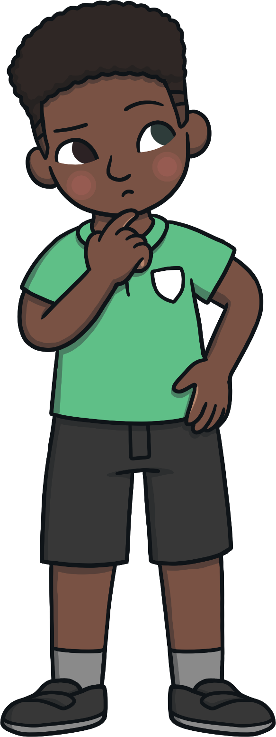
What is a clause?
The subject of a sentence is the person or thing that is carrying out the main action of that sentence.
Verbs can describe an action (e.g. sing, climb), emotion (e.g. loves, hates), thought (e.g. thinks), opinion (e.g. believes) or state of being (e.g. am, is, are, was, were).
A clause is a group of words that contains a verb and a subject.
There are two types of clauses, main and subordinate.

Slide 3
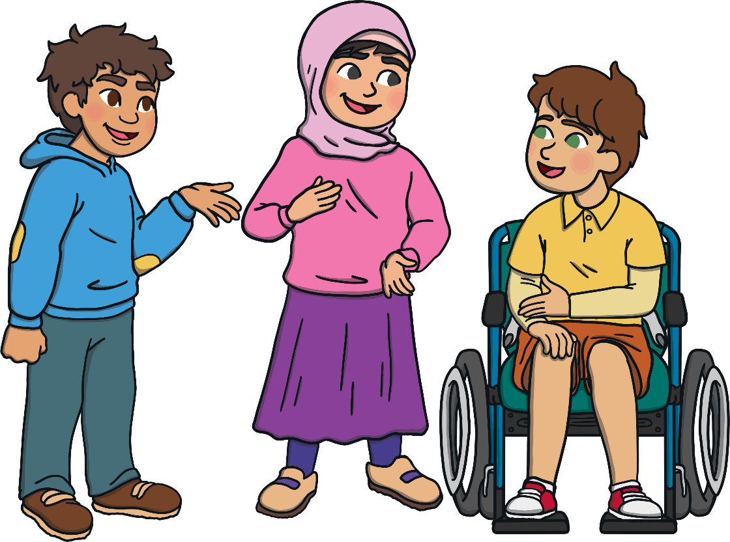
Main Clause
A main clause is the key part of a sentence. Every sentence has a main clause. A main clause can form a complete sentence; it makes sense on its own.

Slide 4

Subordinate Clause
A subordinate clause gives us more information about the main clause. If we removed the main clause, a subordinate clause would not make sense on its own, it is not a ‘full’ sentence.

Slide 5

Simple Sentences
A simple sentence has just one main clause.
For example:
Bluebells are protected flowers.

Slide 6

Compound Sentences
A compound sentence will include two main clauses (they will both make sense on their own and have equal importance in the sentence).
The main clauses will be linked together by a type of word called a ‘co-ordinating conjunction’: and; so; but; or; for; yet; nor.
For example:
Bluebells are protected flowers and uprooting wildflowers without permission is not allowed in Northern Ireland.
Main clause: Bluebells are protected flowers.
Main clause: Uprooting wildflowers without permission is not allowed in Northern Ireland.
Co-ordinating conjunction: and

Slide 7
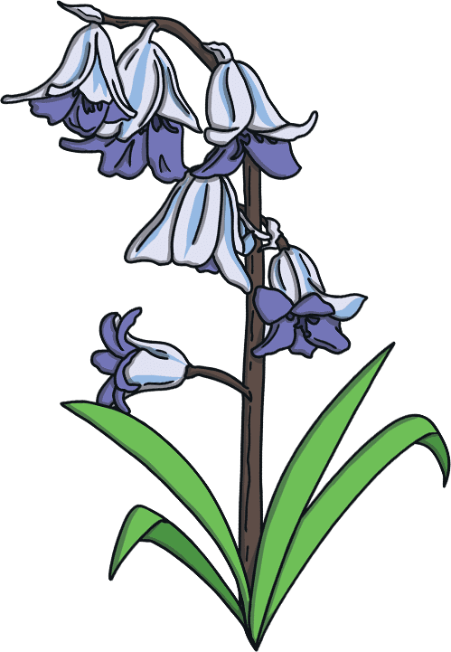
Complex Sentences
Complex sentences will include a main clause and a subordinate clause or clauses. The subordinate clause will add more detail to the main clause, but will not make sense on its own. Wherever it appears in the sentence, a subordinate clause will usually begin with a type of word called a ‘subordinating conjunction’. This word or words will explain how the information is linked to the main clause.
For example:
It is illegal to intentionally pick, uproot or destroy bluebells because they are protected flowers.
Main clause: It is illegal to intentionally pick, uproot or destroy bluebells.
Subordinate clause: they are protected flowers.
Subordinating conjunction: because

Slide 8
Activity 1
Read the sentence and decide if it is a simple, compound or complex sentence.
Roses are red and violets are blue.
Compound

Slide 9
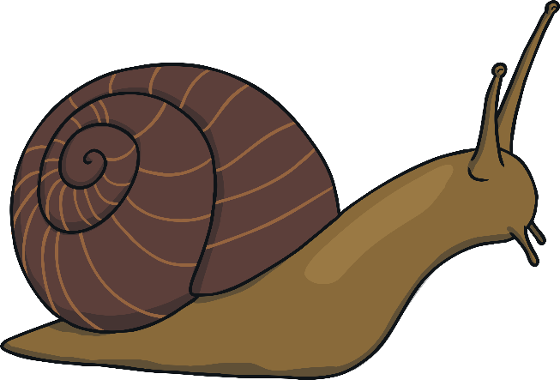
Activity 2
Read the sentence and decide if it is a simple, compound or complex sentence.
I can search for minibeasts, now that I’ve
finished my homework.
Complex

Slide 10
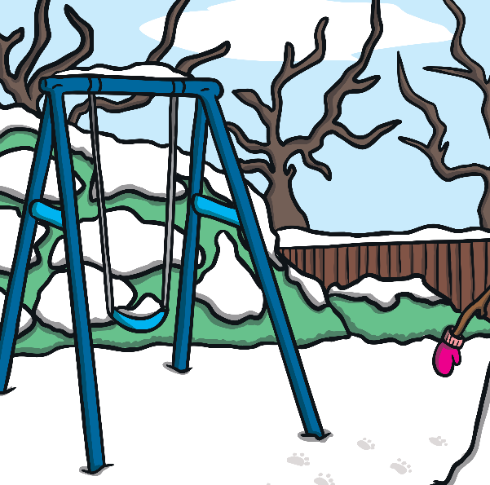
Activity 3
Read the sentence and decide if it is a simple, compound or complex sentence.
Wintry weather might include frost, hail, sleet and snow.
Simple

Slide 11
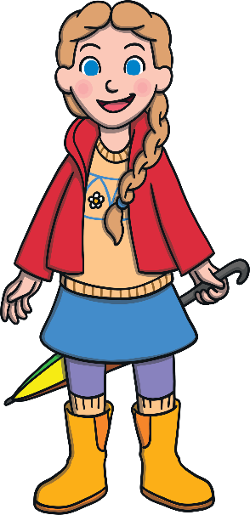
Activity 4
Read the sentence and decide if it is a simple, compound or complex sentence.
Even though it was about to rain, I wanted to go for a walk.
Complex

Slide 12

Activity 5
Read the sentence and decide if it is a simple, compound or complex sentence.
Many trees are bare in winter but evergreen trees do not lose their leaves.
Compound

Slide 13
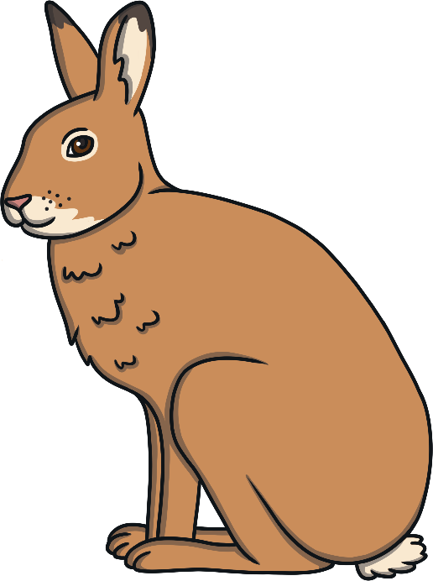
Activity 6
Read the sentence and decide if it is a simple, compound or complex sentence.
During spring, hares can be spotted ‘boxing’ one another, as the females will sometimes fight off the attention of the males.
Complex

Slide 14
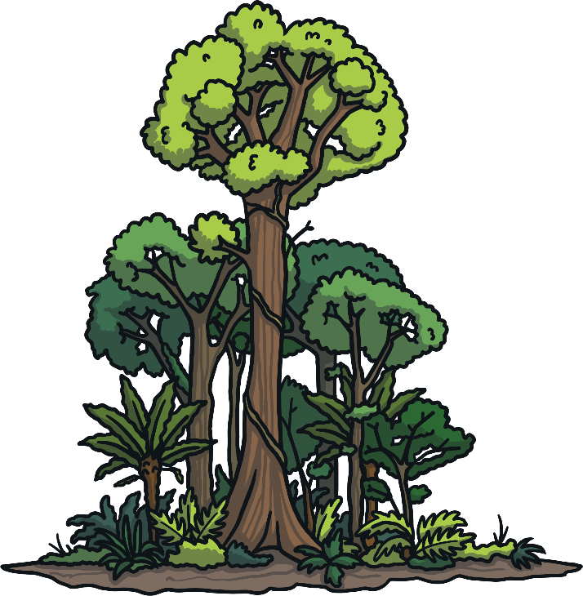
Activity 7
Read the sentence and decide if it is a simple, compound or complex sentence.
Photosynthesis is the name for the process in which green plants make their own food.
Simple

Slide 15
Activity 8
Read the sentence and decide if it is a simple, compound or complex sentence.
The winter solstice occurs in December and the summer solstice takes place in June.
Compound

Slide 16
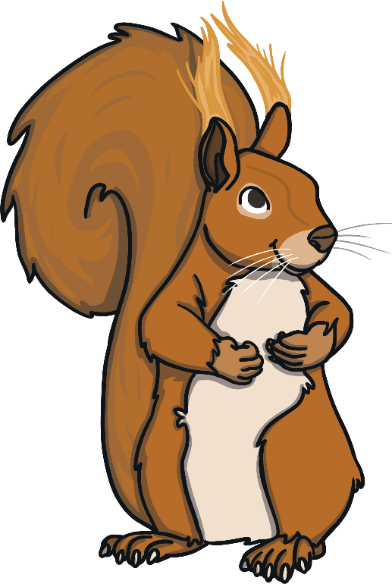
Activity 9
Read the sentence and decide if it is a simple, compound or complex sentence.
Although they may be much less active in winter, red squirrels do not hibernate.
Complex

Slide 17
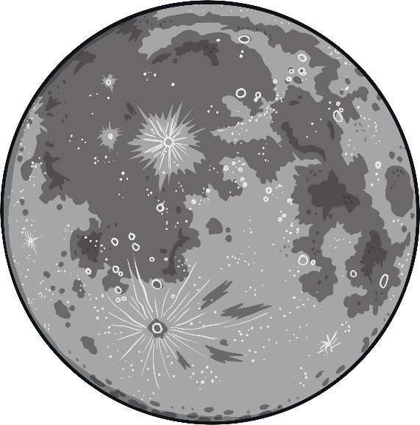
Activity 10
Read the sentence and decide if it is a simple, compound or complex sentence.
The full moon that occurs closest to the autumn equinox is known as the Harvest Moon.
Simple

Slide 18

Activity 11
Read the sentence and decide if it is a simple, compound or complex sentence.
Once the rain had stopped, the bees began buzzing around the flowers again.
Complex

Slide 19

Activity 12
Read the sentence and decide if it is a simple, compound or complex sentence.
Snowdrops are one of the first flowers that appear each year, even blooming in frost or snow.
Complex

